Slide 1
Computational Genomics WS
Sliding Window Tests
Combining Statistics and Dealing with Missing Data

Slide 2
Reminders:
2 weeks from Today: Final Project Presentations!!
Next Week: Running R on the Cluster
Please sign up for a Palmetto account if you don’t have one already (see https://www.palmetto.clemson.edu/palmetto/)!
Make sure you are able to log in (see their instructions here: https://www.palmetto.clemson.edu/palmetto/userguide_basic_usage.html)
Mac users: the Terminal app they are talking about is located in Applications->Utilities
Review Command Line Basics
A good tutorial is here: https://ryanstutorials.net/linuxtutorial/
Section 2 (Basic Navigation) and 5 (File manipulation) are all you will really need to review for class
2nd half of class next week: time to work on your project!
PLEASE HAVE YOUR VCF FILE READY BEFORE CLASS!!!

Slide 3
Outline for Today:
Goals:
Put together the things we’ve learned about in the past weeks to try and test some specific hypotheses in our sample data.
Get more practice with Sliding Window Tests
Learn how to account for missing sequence data
Review McDonald-Kreitman Test and Solutions for Last Week
Today’s Sample Data: Heliconius Butterflies
Model system for Mimicry, Frequency Dependent Selection, and Diversifying Selection
How do we test for specific types of selection?
Review of Tajima’s D and related statistics
Designing a Strategy for a Sliding Windows Test
Picking a window size
Thinking about potential issues with missing data

Slide 4
Review – McDonald-Kreitman Test:
Purpose: Test if genes have been under selection to accumulate more nonsynonymous changes than we would expect under neutrality.
Logic: Nonsynonymous changes lead to changes in protein structure, which in turn lead to changes in phenotype that would be the targets of selection.
Distinguishing Fixed Differences from Polymorphic Differences
Species 1
Species 2
Outgroup
Pos. 1: Monomorphic
G
T
G
A
T
G
G
T
G
T
T
A
G
C
C
T
T
A
G
C
C
T
G
G
A
C
G
T
T
G
Pos. 2: Fixed
Pos. 3: Fixed
Pos. 4: Polymorphic
Pos. 5: Polymorphic
Pos. 6: Polymorphic
Notes:
What would this look like in VCF format??

Slide 5
Review – McDonald-Kreitman Test:
Purpose: Test if genes have been under selection to accumulate more nonsynonymous changes than we would expect under neutrality.
Logic: Nonsynonymous changes lead to changes in protein structure, which in turn lead to changes in phenotype that would be the targets of selection.
Results:
Both genes had significantly higher rates of non-synonymous change between species than within.
LYST: white fur color
APOB: ability to eat a high fat diet

Slide 6
Müllerian Mimicry & Positive Frequency Dependent Selection
Individuals A, B, C, and D are ALL toxic,
BUT that doesn’t help unless the predator knows they’re toxic!
Predators learn what individuals to avoid through experience.
If you have a color pattern that is common (has a high frequency), there is a better chance a predator you encounter has already learned to stay away from things that look like you.
If you have a rare pattern, you are at higher risk of a predator thinking it’s okay to eat you.

Slide 7
Müllerian Mimicry & Positive Frequency Dependent Selection
The fitness of a color pattern depends on how frequent it is in the population: higher frequency = better!
Result: Convergence on one color pattern within and even across species – each species gets the benefit of the commonly recognized warning signal to predators.

Slide 8
Heliconius Butterflies
Different species have locally converged on one phenotype.
But different populations of the same species can look very different, because they are under selection for whatever pattern is the most common in their area.
Species 1
Species 2
Parchman et al. (2007) Current Opinion in Genetics & Development 17(4): 300-308

Slide 9
Heliconius Butterflies
Different species have locally converged on one phenotype.
But different populations of the same species can look very different, because they are under selection for whatever pattern is the most common in their area.
Species 1
Species 2
Parchman et al. (2007) Current Opinion in Genetics & Development 17(4): 300-308

Slide 10
Heliconius Butterflies
All of these diverse patterns have been linked to a few “supergenes”!
Balancing Selection maintains the different color patterns across species
Divergent sexual selection (females prefer males with a matching color pattern) limits hybridization between different color morphs.

Slide 11
For Today’s Exercise:
VCF file of a 2 Mb region containing 1 putative “supergene.”
2 color morphs from the same species (H. melpomene), 4 individuals each
Can we detect evidence for Balancing Selection in this region?
What about Divergent selection?

Slide 12
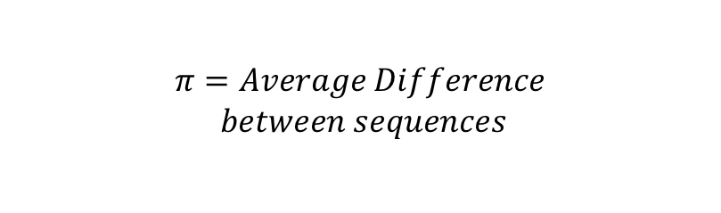
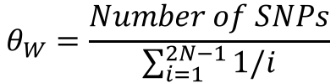
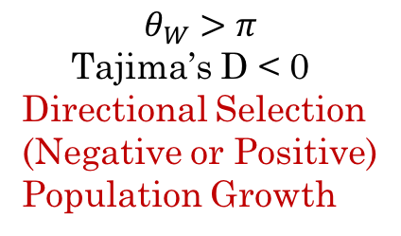
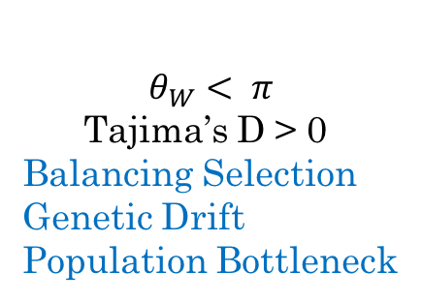
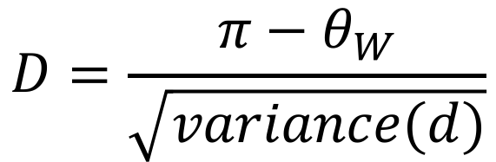
Review: Tajima’s D
$$D=\frac{{π−θ}_{W}}{\sqrt{variance(d)}}$$
$$π=Average Difference$$
$$between sequences$$
$$θ_{W}=\frac{Number of SNPs}{\sum_{i=1}^{2N−1}{1/i}}$$
$$θ_{W}>π$$
Tajima’s D < 0
Directional Selection
(Negative or Positive)
Population Growth
$$θ_{W}< π$$
Tajima’s D > 0
Balancing Selection
Genetic Drift
Population Bottleneck

Slide 13
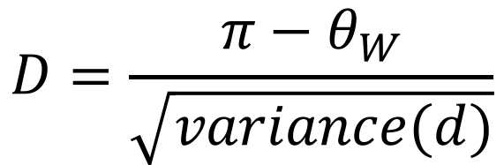
Tajima’s D: Strengths & Weaknesses
Strengths:
Can distinguish Balancing Selection from Directional Selection
Not too hard to calculate (no likelihood model fitting)
Weaknesses:
Genetic drift could lead to false positives
Looked very noisy when we did it last time...
$$θ_{W}< π$$
Tajima’s D > 0
Balancing Selection
Genetic Drift
Population Bottleneck
$$D=\frac{{π−θ}_{W}}{\sqrt{variance(d)}}$$

Slide 14
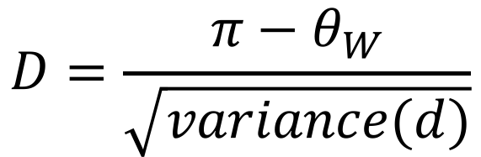
Tajima’s D: Strengths & Weaknesses
Strengths:
Can distinguish Balancing Selection from Directional Selection
Not too hard to calculate (no likelihood model fitting)
Weaknesses:
Genetic drift could lead to false positives
Looked very noisy when we did it last time...
Sliding window approach could help with this – drift should affect the whole genome, while selection won’t
Let’s plot 𝛳_{W} and 𝜋 along with D this time – maybe then we can sort out which component made D so variable
$$θ_{W}< π$$
Tajima’s D > 0
Balancing Selection
Genetic Drift
Population Bottleneck
$$D=\frac{{π−θ}_{W}}{\sqrt{variance(d)}}$$

Slide 15
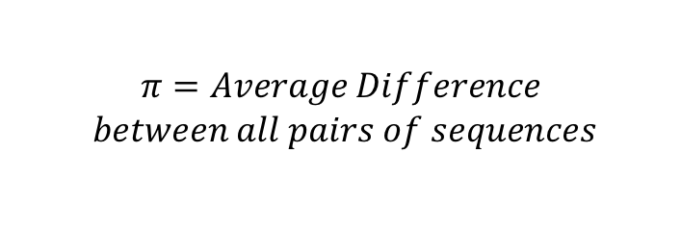
Nucleotide Divergence (D_{XY})
$$π=Average Difference$$
$$between all pairs of sequences$$
Nucleotide Diversity
D_{xy} ≡ 𝜋_{xy} = Average Difference between sequences from 2 different groups
Nucleotide Divergence
Function for D_{xy} is provided for you!

Slide 16
Sliding Window Tests Revisited
600bp
600bp
Two Weeks Ago: We used 600 bp Sliding Windows, and we divided our data up into discrete regions (i.e. there was no overlap between them)

Slide 17
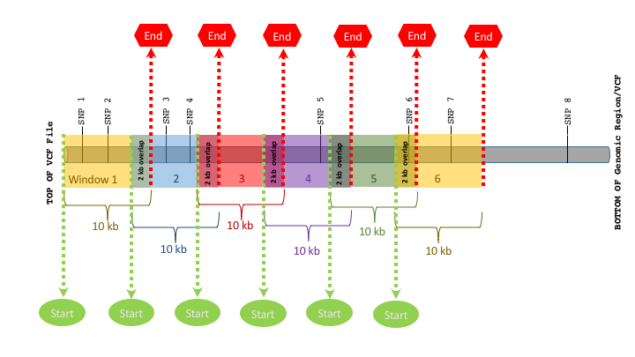
Sliding Window Tests Revisited
This week: We will use 10,000 bp windows, and we will allow 2,000 bp of overlap between them – this will help us not to miss anything!
10 kb is a large enough to contain 2, maybe 3 genes,
But the signal we are looking for involves a “supergene” cluster, so it makes sense to scan a bigger region
2 kb overlap helps make sure we don’t miss something just by arbitrarily cutting up our genome

Slide 18
Sliding Window Tests: Missing Sequence Data
With short read data (i.e. next-gen sequencing data), we are aligning very small reads to a reference, and we need a certain amount of overlap to even be able to call a SNP.
Some regions of the genome can have more coverage than others.

Slide 19
Sliding Window Tests: Missing Sequence Data
No matter how much sequencing you do, you will almost ALWAYS have some gaps, because certain regions of the reference genome are un-mappable (highly repetitive regions, centromeres, telomeres…)

Slide 20
Sliding Window Tests: Missing Sequence Data Why does it matter?
X = 0
X =10
If we see a big difference in some statistic (X) between these 2 windows, then that would be a meaningful result, and suggest something biologically real was happening

Slide 21
Sliding Window Tests: Missing Sequence Data Why does it matter?
X = 0
X =10
BUT, if we see a big difference between these 2 windows, it is just because the first window has no data, so we don’t know what is going on!
In this case, X should really be “NA”, not 0!

Slide 22
Sliding Window Tests: Missing Sequence Data What can we do?
You could use a different file format (typically the SAM/BAM file) that has the read mapping information
Some current programs do this (e.g. popBAM)
But these files can be very big (they have information for every read), and harder to parse than VCF
OR, you can use a VCF file that has both variant and invariant sites (what we will do today)
Most (all?) SNP callers that generate VCF format have an option also output invariant sites (e.g. GATK, varFilter, freeBayes)
These programs create VCF files from BAM files, so if you have BAM you can generate new VCFs
With this method, you can easily apply the same quality and coverage filters to ALL of the data

Slide 23
Today’s Exercise:
Divide our data up into 10kb windows with 2kb of overlap
Figure out how many total bp (non-variant and variant sites) are in each window.
Calculate Tajima’s D, 𝛳_{W}, and 𝜋 in each window (exactly what we did 2 weeks ago).
Calculate D_{xy} in each window (function provided).
Make a fancy plot.
Try the test(s) of your choice on the data, to see if you can find more evidence for (or against) a certain type of selection occurring in this region.

